Slide 1
DAA_Assignment 2 (Day 1)
Yash NC
181210062

Slide 2
Representations of graphs
There are two standard ways to represent a graph G = (V, E): as a collection of adjacency lists or as an adjacency matrix.

Slide 3
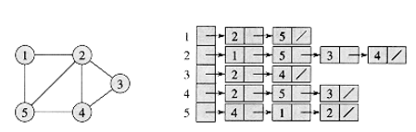
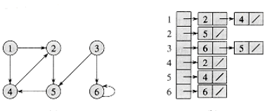
Adjacency - List Representation
The adjacency-list representation of a graph G = (V, E) consists of an array Adj of |V| lists, one for each vertex in V. For each u V, the adjacency list Adj[u] contains (pointers to) all the vertices v such that there is an edge (u,v) E. That is, Adj[u] consists of all the vertices adjacent to u in G. The vertices in each adjacency list are typically stored in an arbitrary order.
Representations of graphs
Undirected Graph
Directed Graph

Slide 4
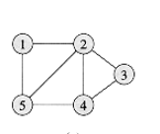
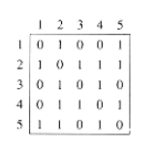
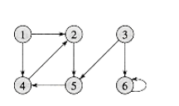
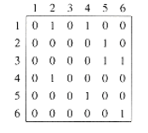
Adjacency-Matrix Representation
For a simple graph with vertex set V, the adjacency matrix is a square |V| × |V| matrix A such that its element Aij is one when there is an edge from vertex i to vertex j, and zero when there is no edge. The diagonal elements of the matrix are all zero, since edges from a vertex to itself (loops) are not allowed in simple graphs. It is also sometimes useful in algebraic graph theory to replace the nonzero elements with algebraic variables.
Representations of graphs

Slide 5
Breadth - first search (DFS)
Depth First Search is an algorithm for traversing or searching tree or graph data structures

Slide 6
It starts at the tree root, and explores all of the neighbor nodes at the present depth prior to moving on to the nodes at the next depth level. It uses the opposite strategy as depth-first search, which instead explores the node branch as far as possible before being forced to backtrack and expand other nodes.
The algorithm starts with examining the node A and all of its neighbours. In the next step, the neighbours of the nearest node of A are explored and process continues in the further steps. The algorithm explores all neighbours of all the nodes and ensures that each node is visited exactly once and no node is visited twice
The time complexity can be expressed as O(|V|+|E|), since every vertex and every edge will be explored in the worst case. V is the number of vertices and E is the number of edges in the graph.
Breadth First Search

Slide 7
Breadth First Search (Procedure)
Step 1: SET STATUS = 1 (ready state) for each node in G
Step 2: Enqueue the starting node A and set its STATUS = 2 (waiting state)
Step 3: Repeat Steps 4 and 5 until QUEUE is empty
Step 4: Dequeue a node N. Process it and set its STATUS = 3 (processed state).
Step 5: Enqueue all the neighbours of N that are in the ready state (whose STATUS = 1) and set their STATUS = 2 (waiting state) [END OF LOOP]
Step 6: EXIT

Slide 8
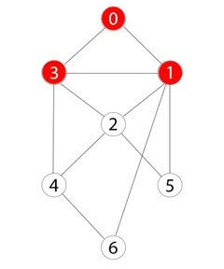
Breadth First Search (Example)
Breadth - First Search starting at 0, Mark 0 as visited and insert 0 to the Queue. Then, traverse the unvisited adjacent nodes (i.e. 3 and 1), Now mark 3 and 1 as visited and insert them into the Queue. Traversing iterations should be repeated until all nodes are visited.Once all the nodes are visited then delete the nodes on the queue and print them as they are deleted.
Result : 0,1,2,3,4,5,6

Slide 9
Breadth - first search (Applications)
P2P Networks
Web Crawlers
Navigation System
Network Broadcasting

Slide 10
Depth-first search (DFS)
Depth First Search is an algorithm for traversing or searching tree or graph data structures

Slide 11
The DFS algorithm is a recursive algorithm that uses the idea of backtracking. It involves exhaustive searches of all the nodes by going ahead, if possible, else by backtracking.Backtrack means that when you are moving forward and there are no more nodes along the current path, you move backwards on the same path to find nodes to traverse. All the nodes will be visited on the current path till all the unvisited nodes have been traversed after which the next path will be selected.
\Depth first search (DFS) algorithm starts with the initial node of the graph G, and then goes to deeper and deeper until we find the goal node or the node which has no children. The algorithm, then backtracks from the dead end towards the most recent node that is yet to be completely unexplored. The data structure which is being used in DFS is stack. In DFS, the edges that leads to an unvisited node are called discovery edges while the edges that leads to an already visited node are called block edges.
Depth First Search

Slide 12
Depth First Search (Procedure)
Step 1: SET STATUS = 1 (ready state) for each node in G
Step 2: Push the starting node A on the stack and set its STATUS = 2 (waiting state)
Step 3: Repeat Steps 4 and 5 until STACK is empty
Step 4: Pop the top node N. Process it and set its STATUS = 3 (processed state)
Step 5: Push on the stack all the neighbours of N that are in the ready state (whose STATUS = 1) and set their STATUS = 2 (waiting state) [END OF LOOP]
Step 6: EXIT

Slide 13
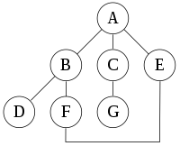
Depth First Search (Example)
Depth-First Search starting at A, assuming that the left edges in the shown graph are chosen before right edges, and assuming the search remembers previously visited nodes and will not repeat them ,will visit the nodes in the following order: A, B, D, F, E, C, G. Performing the same search without remembering previously visited nodes results in visiting nodes in the order A, B, D, F, E, A, B, D, F, E, etc. forever, caught in the A, B, D, F, E cycle and never reaching C or G. Iterative deepening is one technique to avoid this infinite loop and would reach all nodes.

Slide 14
Depth-first search (Applications)
Topological SORT
Hierarchical distribution networks
Cycle Recognition
Solve a maze by Traversing

